Slide 1
Youth Who Thrive
Developed from a review of the critical factors and effective programs for 12-25 year olds
Prepared for the YMCA of Greater Toronto and United Way Toronto
By The Students Commission of Canada and the Social Program Evaluation Group at Queen’s University
Notes:
The review was commissioned by the YMCA of Greater Toronto and United Way of Toronto to ensure youth programs are focused on the right outcomes for youth 12 to 25. The review was conducted by the Social Program Evaluation Group at Queen’s University and The Students Commission of Canada, lead of the Centre of Excellence for Youth Engagement.
A Project Advisory Committee from various external organizations helped the research team develop search words and criteria for evaluating the quality of the evidence. Only research studies that met the standards were included. The research team found and reviewed 407 peer-reviewed academic studies and 223 organizational studies from 2000-2013 that met the criteria. Standards of evidence were also applied to three major theoretical frameworks and 18 program interventions.
Not all knowledge is included in the literature review; there are many organizations developing and delivering programs without the resources to conduct evaluations that meet academic publishing requirements or standards of evidence established for this review

Slide 2
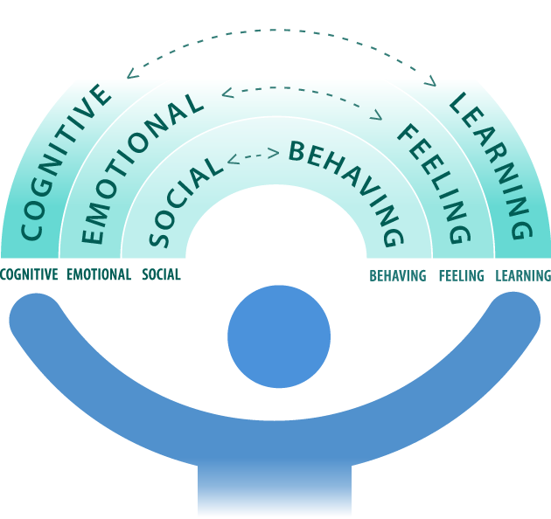
Youth Who Thrive
To thrive, young people need to experience positive results, or outcomes, in three areas:
learning or cognitive
feeling or psychological/emotional
behaving or behavioural/social
FEELING
LEARNING
BEHAVING
Notes:
Thriving encompasses being physically healthy and developing the capacity to learn, the capacity to feel good about one’s self, and the capacity to behave well socially and societally.
Since the middle of the 20th century, policy-makers and researchers have been increasingly interested in the factors that influence adolescent development field and have moved more and more from studying deficits and problems to a positive youth development approach looking what promotes and supports youth to developing strengths, resiliency, and skills to thrive.
The strongest determinants of adolescent health worldwide are structural factors in society, such as income inequality and access to education. However, effective youth programs can contribute to positive physical health, learning, emotional and behavioural outcomes for youth. Youth who thrive in these domains tend to positively impact their communities and experience long-term health and well-being in adulthood.
Learning successfully or Cognitive/learning outcomes refer to cognitive-related achievements such as higher achievement test scores, effective learning strategies, and commitment to lifelong learning.
Feeling good or Psychological/emotional outcomes refer to healthy intrapersonal achievements, for example, healthy self-image, contentedness, and low levels of depression.
Behaving well or Behavioural/social outcomes refer to success relating to interpersonal exchanges including positive social interactions, community involvement, and assumption of leadership roles.

Slide 3
Three critical factors to promote youth thriving in adolescence are:
autonomy
relatedness
competence
These factors were common across the major approaches to positive youth development which had the strongest supporting evidence.
Notes:
Scientific evidence for major theories of youth development and thriving were reviewed. Of those with strongest evidence, three critical factors were common to all —Autonomy, Relatedness, Competence
Reorganizing these approaches into three common critical factors provides a simple way to summarize your program framework, communicate how your program supports youth to thrive, and ground your program in current research evidence, no matter your approach.
The three major approaches useful for designing youth programming that have the strongest evidence are 40 Developmental Assets™, the Five Cs, and Self-Determination Theory (SDT).
Developmental Assets™ from The Search Institute provides a list of 40 assets that help youth thrive. The theory is that the more of these positive factors young people have, the more likely they are to become healthy, successful, and happy. The list includes internal personal assets, such as self-esteem, honesty, and skills (e.g., planning). External assets include positive family, caring school, and involvement in positive youth programs.
The Five Cs are five core principles of positive youth development: competence, confidence, connection, character, and caring/compassion. Collectively, the Five Cs can result in a sixth C, contribution. Youth who build all of the Five Cs are more likely to thrive.
The evidence was first provided by the 4-H Study of Positive Youth Development, focusing on Head, Heart, Hands and Health begun in 2002 and continuing today.
According to Self-Determination Theory, individuals’ ability to reach their goals is dependent on how much they can fulfill three basic psychological needs: 1) autonomy, 2) relatedness, and 3) competence. In other words, people can better reach their goals when they can make their own decisions to reach for a goal (autonomy), when they connect and interact meaningfully with others (relatedness), and when they have skills to put their ideas into action (competence).

Slide 4
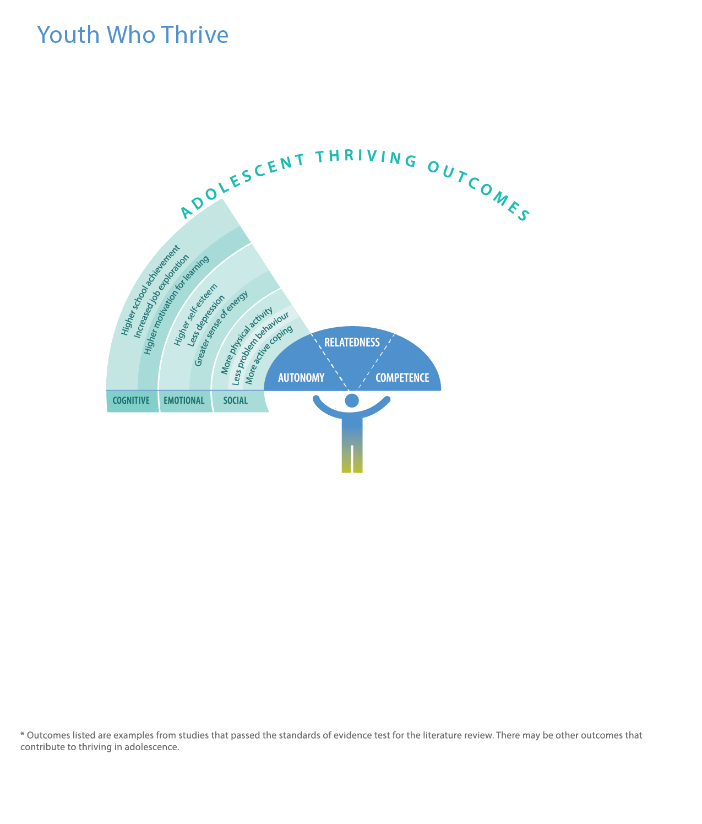
Autonomy is:
Input, voice, or agency in determining one’s own choices and acting upon personal interests, values, and goals.
Autonomy outcomes include:
Increased job exploration learning
Higher self-esteem feeling
More physical activity behaving
Notes:
Programs that support autonomy provide invitations to decide what youth want to do, invitations to decide how they want to do it, and assistance as needed.
Autonomy is a critical factor for positive outcomes in learning successfully (cognitive), feeling good (psychological/emotional) and behaving well (behavioural/social) domains. Further, autonomy is a critical protective factor in terms of negative behavioural and psychological/emotional outcomes. In turn, these outcomes are associated with long-term well-being.
However, the connection between autonomy and outcomes is not consistent across research studies. The domain(s), timing, and amount of autonomy that are critical for positive adolescent outcomes and long-term thriving are affected by gender, age, and risk status. Furthermore, greater specificity with respect to type and dosage of autonomy may well prove beneficial for understanding different youth outcomes across adolescence.

Slide 5
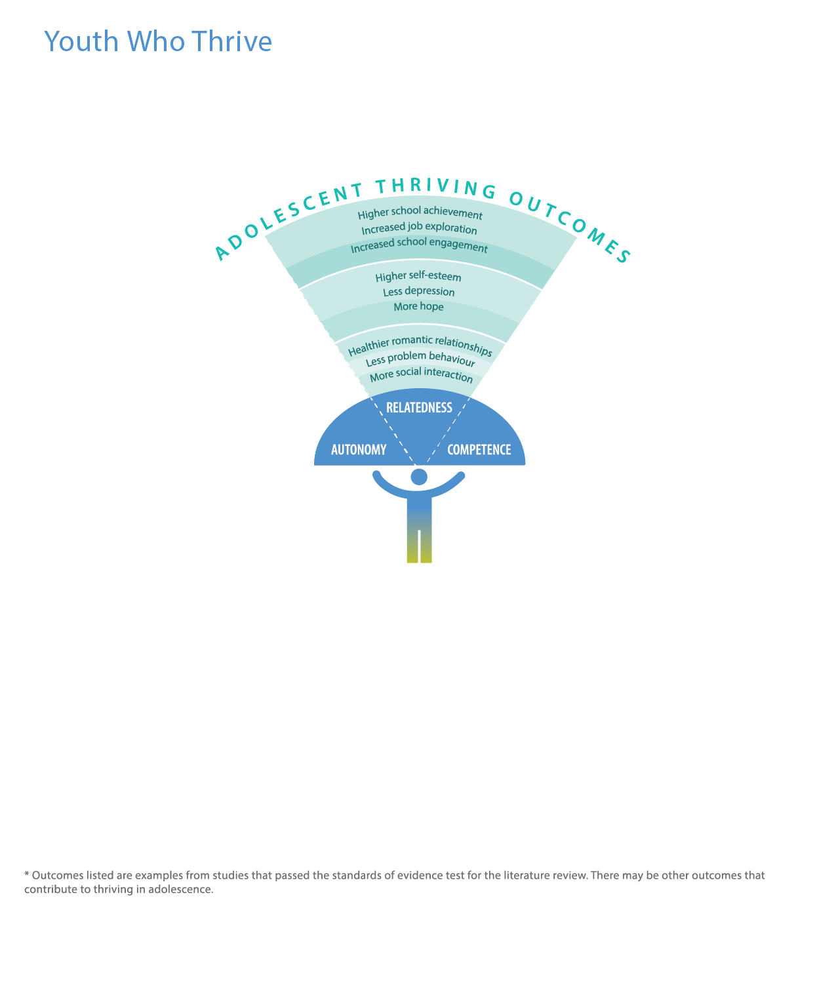
Relatedness is:
A sense of belonging and connection with others.
Relatedness outcomes include:
Increased school engagement learning
Less depression feeling
More social interaction behaving
Notes:
Programs that promote relatedness provide inclusive environments, consistent youth-adult relationships that last at least 6 months and frequent youth/adult contact, involvement and closeness.
Relatedness is a critical factor for positive outcomes in learning successfully (cognitive/learning domain) and feeling good about one’s self (psychological/emotional domain) and a critical protective factor in behaving well ( behavioural/social domain). The presence of relatedness is critical for school achievement, motivation, engagement, career development, and hope. In turn, these outcomes are associated with long-term achievement, psychological and behavioural adjustment and well-being.

Slide 6
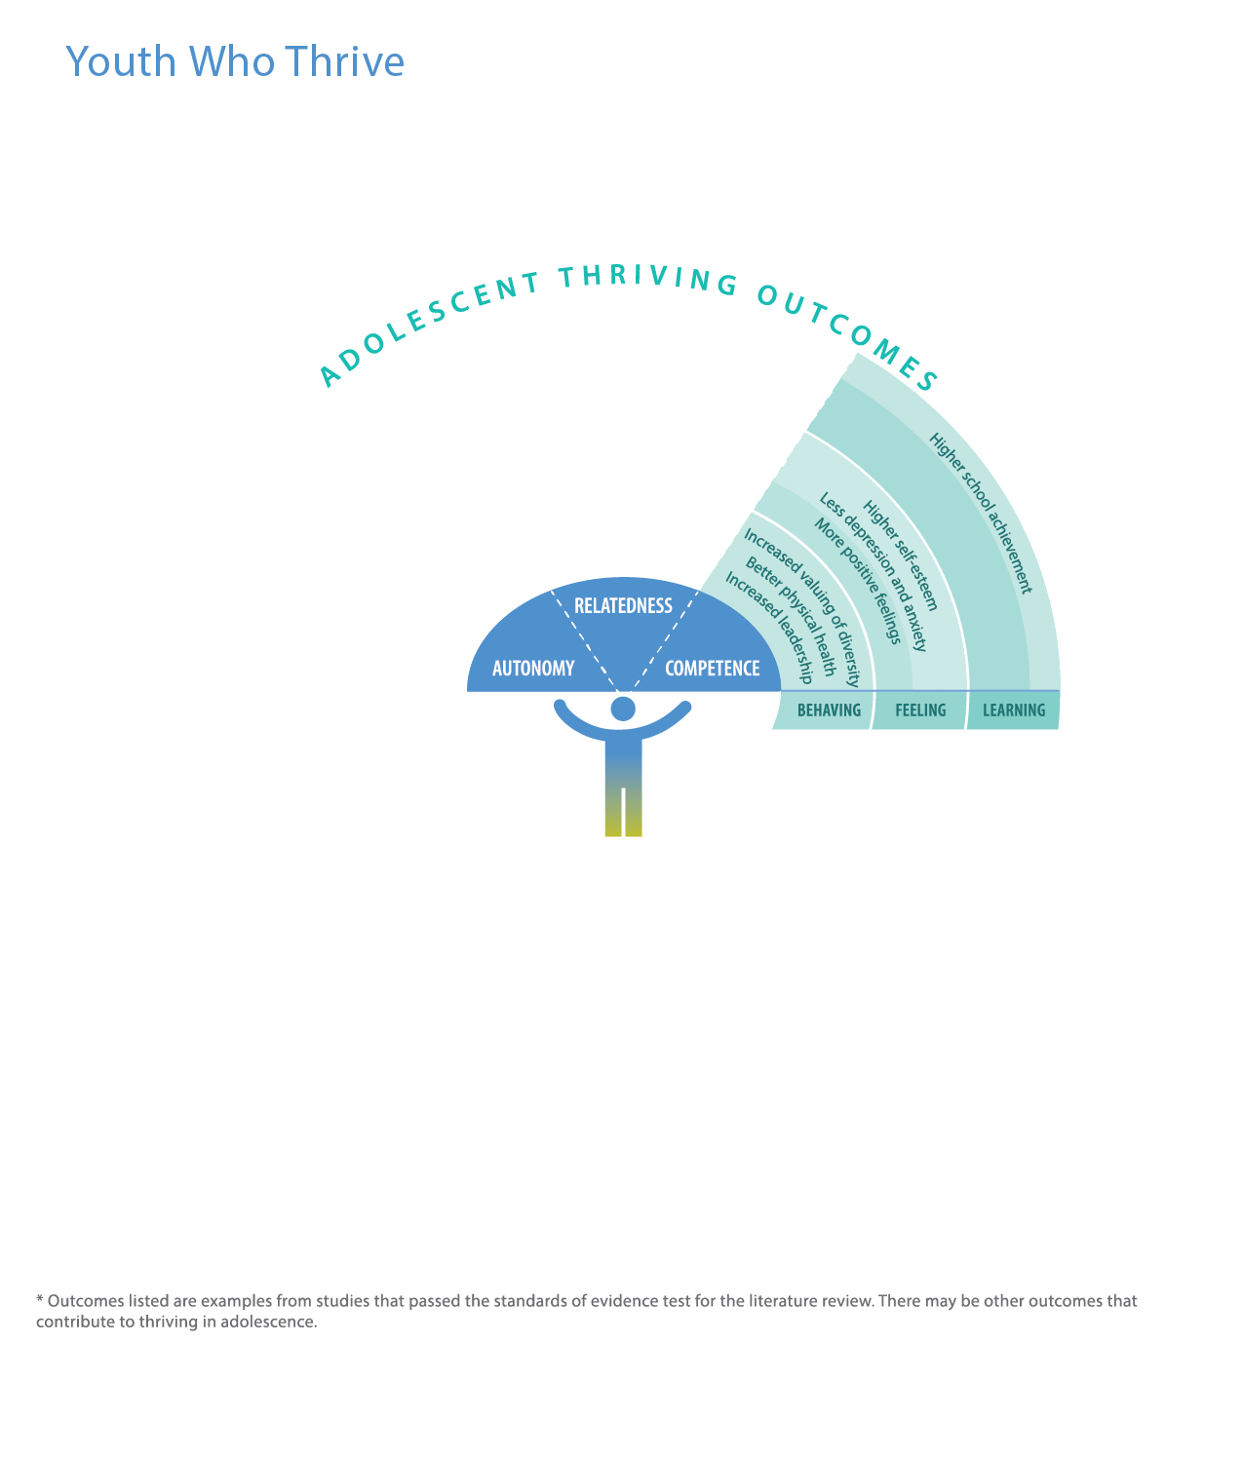
Competence is:
Having skills to effectively achieve desired goals.
Competence outcomes include:
Higher school achievement learning
Less depression and anxiety feeling
Increased leadership behaving
Notes:
Programs that promote competence provide:
opportunities for skill building and mastery over time;
opportunities to develop emotional, social and cultural competences; and
opportunities to interact with youth with diverse perspectives and backgrounds.
Competence is a critical factor for positive outcomes in learning successfully (cognitive domain), feeling good about one’s self (psychological/emotional domain) and behaving well (behavioural/social domain). However, the competences are culturally mediated and therefore different competences may be more important in some cultures than in others, with limited evidence to indicate that there are competences that are universal.
Greater specificity about the outcomes related to type of competence, and their relevance for various cultures and ethnic backgrounds, as well as across age and risk level, may prove beneficial for understanding different outcomes across adolescence.
Competence is a critical protective factor for negative behavioural and psychological outcomes. Specific competences, and self-perceptions of those competences, are related to different positive adolescent outcomes. Although social competence or skills are remarkably important, so too are social connections, social character, social confidence, and social contributions. Therefore, competence cannot be fully understood in a vacuum, but in relation with other critical factors in youth and adulthood.

Slide 7
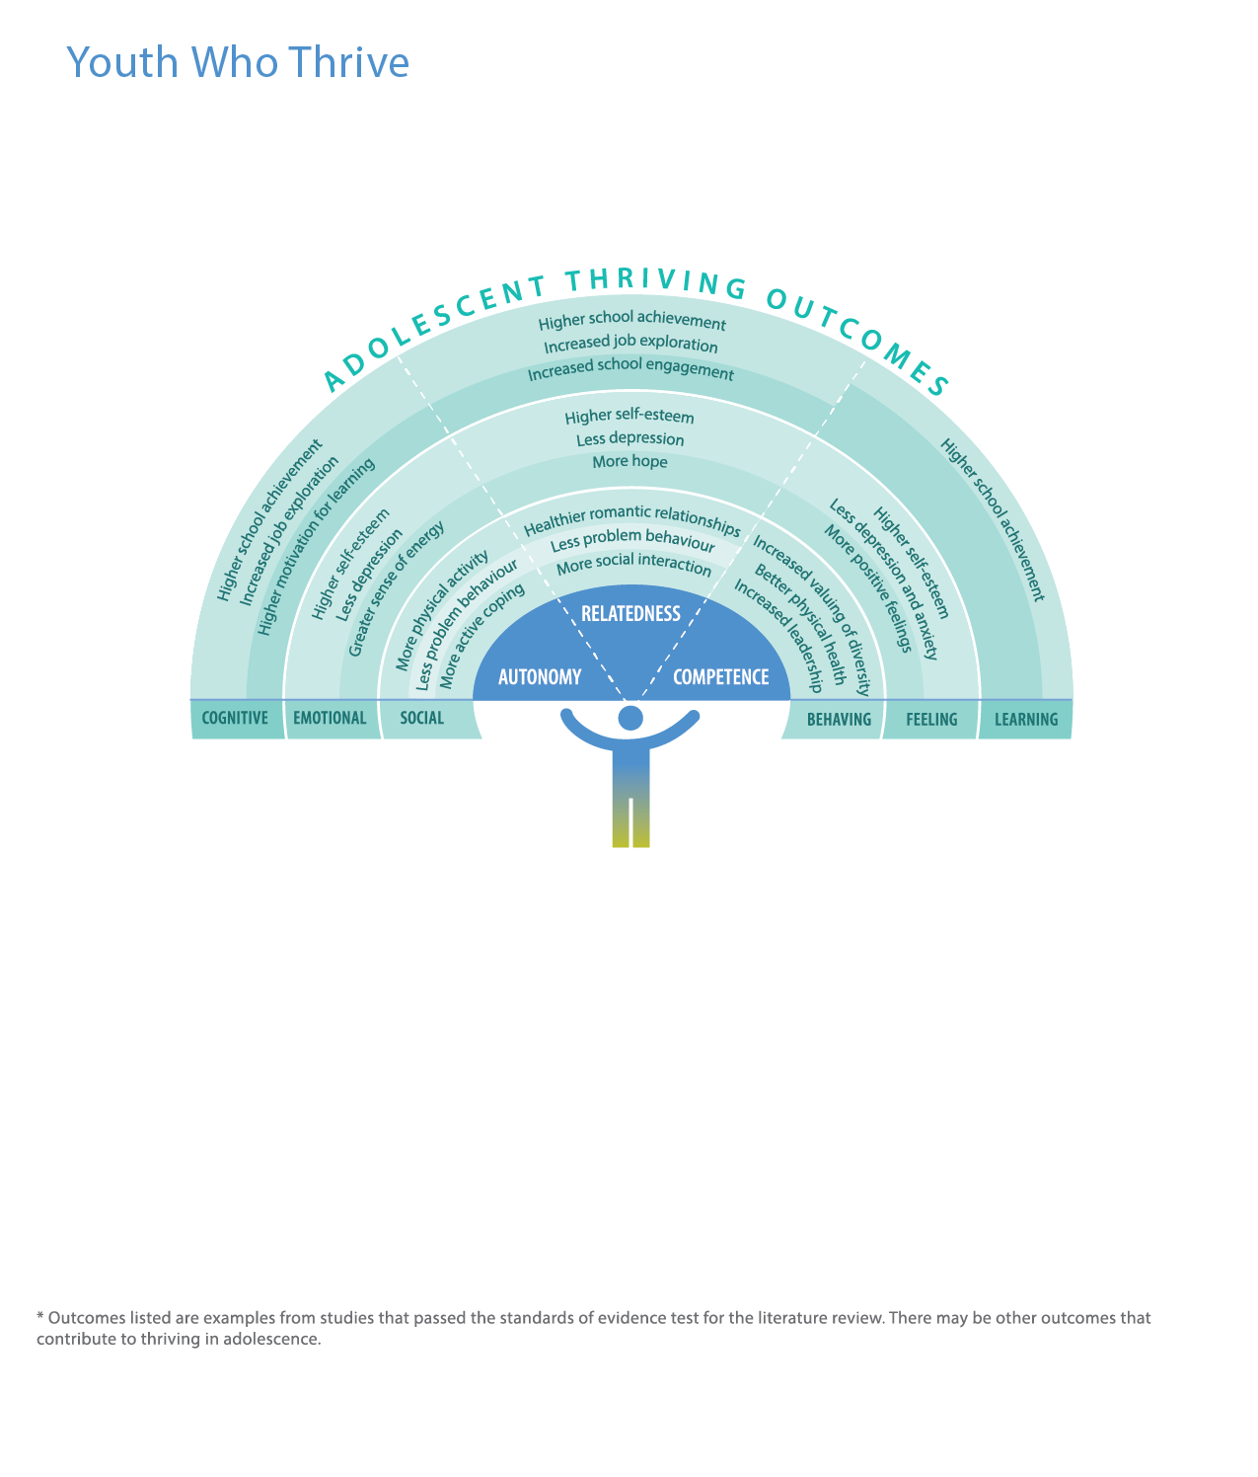
Autonomy, relatedness, and competence are critical for navigating transitions through young people’s lives.
Autonomy, relatedness and competence provide a simplified focus to track and tune-up existing programs.
Notes:
Transitions through the ages of 12 to 25 years involve biological, psychological and environmental changes. Some transitions such as leaving the child welfare system, and early parenting pose extra risks.
Different youth negotiate multiple changes at different times than their peers, within different intra- and inter-cultural environments, with varying resources, and therefore require flexible, culturally appropriate and responsive supports throughout these transitions.

Slide 8
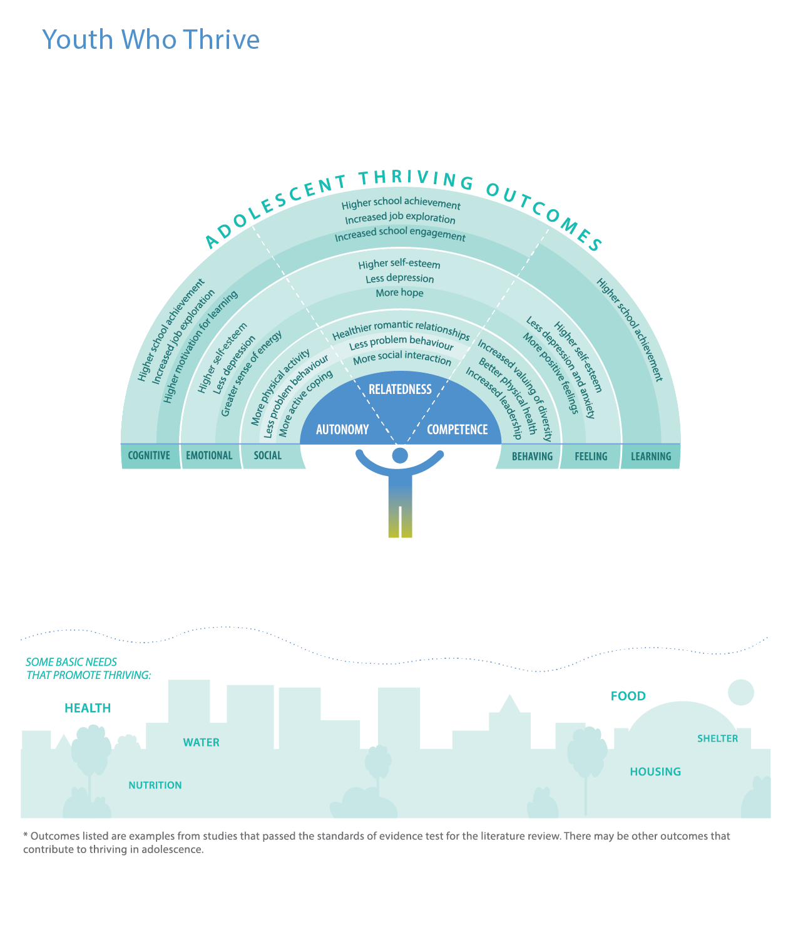
Before programs can support youth to thrive, their basic needs have to be met: food, water, health, housing ….
Some programs help meet basic needs.

Slide 9
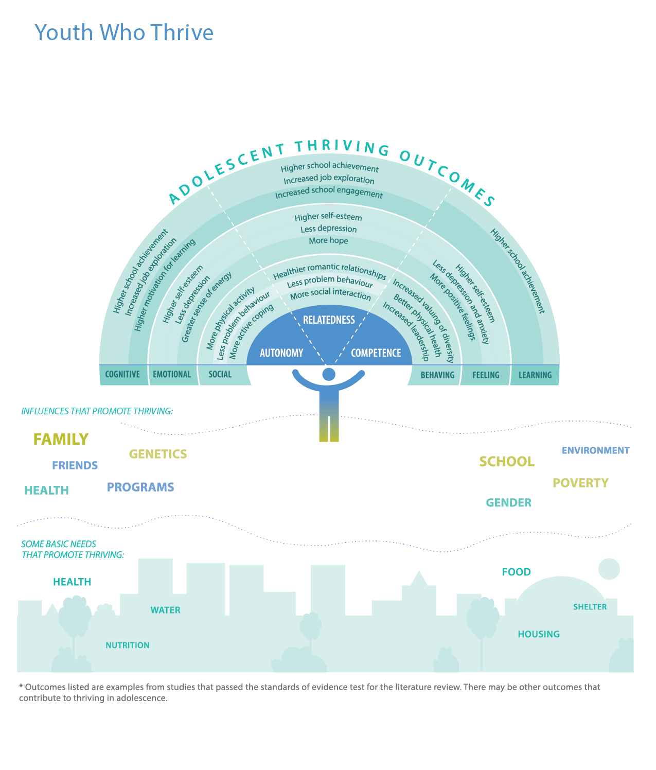
Some other influences that affect thriving include family, friends, genetics, health, school, gender, poverty, environment, and youth programs.
These influences interact, with interconnected effects. Some programs work directly on or with these influences to help youth thrive.
Notes:
The strongest determinants of adolescent health worldwide are structural factors in society such as income inequality and access to education.

Slide 10
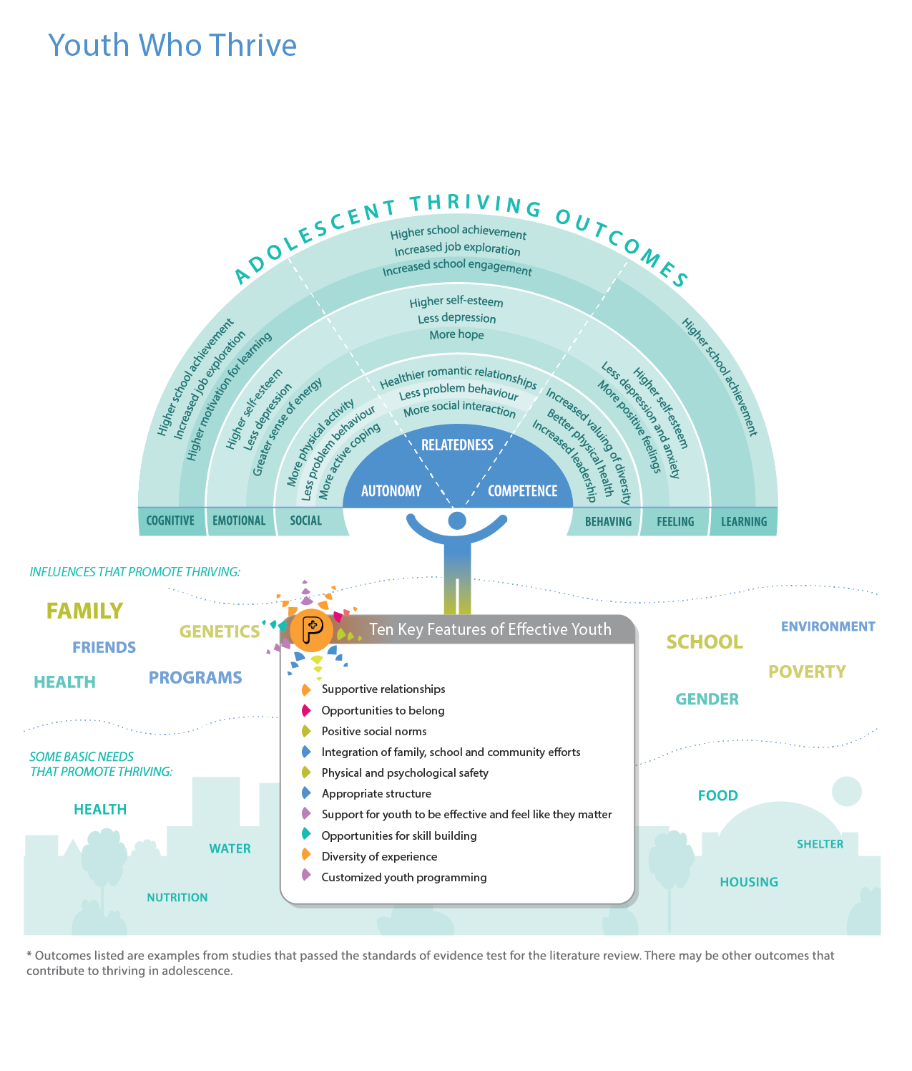
Relatedness program features:
Supportive relationships
Opportunities to belong
Positive social norms
Integration of family, school and community efforts
Notes:
Of 182 studies of programs or interventions captured through the initial literature search, 68 passed the standards of evidence criteria, and of these 18 were relevant to the purposed of this project and were reviewed in depth. Eight features of effective programs that had been identified in a previous comprehensive literature review, Community Programs to Promote Youth Development, conducted in 2002 were reaffirmed by the current review and two new features were added.
1. Build supportive relationships
Relationships with adult mentors are more effective when they are long-lasting and close. When youth have at least one caring adult in their lives, they demonstrate fewer risk-associated behaviours, greater academic achievement, and higher self-esteem. Youth-adult partnerships represent a promising practice; partnerships characterized by collaboration and power-sharing are related to group belonging.
2. Create opportunities to belong
All young people should feel that they belong regardless of their gender, ethnicity, sexual orientation, abilities, socio-economic background or peer affiliations. This feature includes providing young people with opportunities for social inclusion, social engagement, and integration. Building cultural identity, cultural pride, and understanding racism can be important for young people to have a sense of belonging and navigate transitions throughout adolescence and early adulthood.
3. Develop positive social norms
Youth benefit from regular access to positive values through peer role models, adult mentors, and group-developed rules or guidelines. Positive social norms provide a foundation for relatedness and self-determination (autonomy). When designing programs, it is important to intentionally create environments with positive values, such as empathy, that build competence to respond to social justice and ethical issues. Comprehensive programs are more successful in fostering moral development than programs that solely focus on one aspect of young people’s lives. Programs with high staff/participant ratios and programs that meet often are best positioned to serve youth participants.
4. Tap into synergy and integrate family, school, and community efforts
The key to this feature is collaboration across the social settings in which youth are engaged: school, extra-curricular activities, peer groups, family, neighbourhoods, and community organizations. Social environments that work together to create meaningful experiences and decrease risk behavior support positive youth development. Young people benefit when their efforts and values in one area have connections to another. Pooling resources and coordinating priorities across social circles can foster programming that focuses on the needs of a particular neighbourhood.

Slide 11
Autonomy and Competence program features:
Physical and psychological safety like they matter
Appropriate structure
Support for youth to be effective and feel like they matter
Opportunities for skill building
Notes:
5. Ensure physical and psychological safety
For youth to get the most out of their participation, it is essential that they feel safe at all times. Intentionally building social and emotional competences may contribute to creating this sense of safety. For example, youth can collaborate to develop and decide upon shared group guidelines. By actively reflecting and inquiring about their own behaviour, young people can build social and emotional competences. These competences improve personal development, psychological well-being and interactions with others. When youth feel safe, they will be more likely to learn, and participate freely.
6. Provide appropriate structure
Appropriate structure includes creating an environment that has clear boundaries, high expectations, and adult support/supervision as required. This feature involves providing a consistent environment to ensure participants not only feel safe within the environment, but also feel comfortable returning to it.
Programs with unstructured time, a lack of skill-building opportunities, and low adult involvement tend to lack positive social relations and lead to negative outcomes. However, youth benefit from a variety of experiences. Intentionally including unstructured time can lead to positive outcomes in programs that have established positive social contexts. In other words, it is important to consider the role of unstructured time, the specific youth involved, and the social context to understand the potential advantages and disadvantages of each choice made. When designing programs, organizers need to ensure supports, such as adult involvement and established positive social norms, are in place for “unstructured” components.
7. Support youth to be effective and to feel like they matter
The goal of youth programming should extend beyond attendance. In other words, participation must include active engagement to result in positive developmental benefits. Young people need to feel that they matter, that their ideas matter, and that they have the capacity to make a difference. For example, when youth are involved in decision-making about an issue that is important to them, it is important for them to see the results. The academic literature uses the words efficacy and mattering.
8. Provide opportunities for skill building
Young people benefit from opportunities to practice new skills and learn. Youth have to sense they are developing meaningful skills; if tasks do not fit youth’s interests or are not challenging enough, they will not be as meaningful for youth. Mastering increasingly challenging tasks builds confidence and competence and leads to positive development. Programs that empower youth and foster meaningful skill-building usually include multiple sessions per week, individualized feedback, and appropriately challenging tasks.
Summary of Autonomy features:
The extent to which youth feel in control of a program, including decisions about participating in the program and decision-making within the program, contributes to their success in the program.
After-school programs may offer greater autonomy for young people than what is possible within the school context.
A variety of activities and activities that are novel for adolescents (e.g., digital storytelling and travel to different places) may prove particularly beneficial for young people.
Interventions examining autonomy most often are based on the Five Cs framework.
Summary of Competence features:
Competence approaches to intervention can be based on any one of a number of competences.
Developmental, cultural, and contextual elements may be particularly important to consider in designing competence interventions.
Health is a critical outcome of programs focusing on competence, most especially mental health.
Measuring the impact of youth programs on competence is a complex process because there seems to be a strong subject-treatment interaction effect, such that a program beneficial for one young person is not helpful for a seemingly similar young person.

Slide 12
Programs features shared across Autonomy, Relatedness and Competence features:
Diversity of experience
Customized youth programming
Notes:
9. Ensure diversity of experience
Programs that best support youth development include breadth and depth of programming. Breadth and variety of participation may be more significant in some cases than frequency. Participation in multiple programs protects youth from the shortcomings of any individual program, providing more opportunities to increase autonomy, relatedness, and competence. Further, intentionally involving a diversity of perspectives and experiences within a program is a promising practice. When youth experience a new challenge or context that is different from their norm, they become more prepared for the transition to adulthood.
10. Customize youth programming
Youth programming should be as broad as possible (macro), while addressing the unique needs of its population (micro). This balance is best achieved by coordinating and collaborating with all program partners, including youth. Programs can effectively meet the unique needs of specific youth by engaging them in program planning and decision-making. Youth input into program and organizational decision-making increases autonomy, relatedness, and competence. Such input is also a unique contributor to successful development and positive outcomes.

Slide 13
Effective youth programs help improve autonomy, relatedness, and competence.
There are ten key features of effective youth programs:
Supportive relationships
Opportunities to belong
Positive social norms
Integration of family, school and community efforts
Physical and psychological safety like they matter
Appropriate structure
Support for youth to be effective and feel like they matter
Opportunities for skill building
Diversity of experience
Customized youth programming
Notes:
Future research should begin to provide evidence about the specifics of the appropriate “how” and intensities for each of these, and in their various combinations for different demographics such as age, gender, population mixes, transition phases, and abilities.
The first eight features were first described in 2002; the last two features have been added.

Slide 14
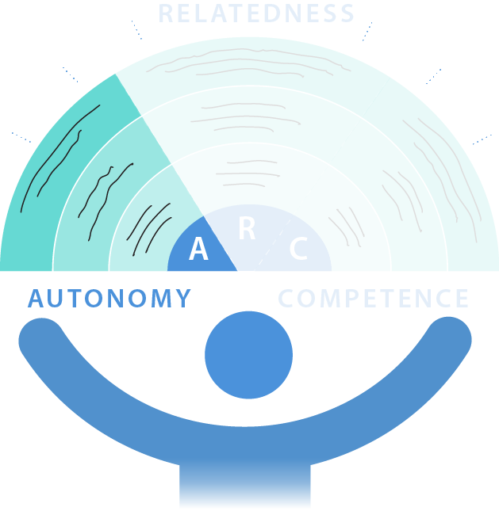
Youth Who Thrive
Programs that promote autonomy provide youth:
invitations to decide what they want to do
invitations to decide how they want to do it
assistance as needed
Notes:
The extent to which youth feel in control of a program, including decisions about participating in the program and decision-making within the program, contributes to their success in the program.
After-school programs may offer greater autonomy for young people than what is possible within the school context.
A variety of activities and activities that are novel for adolescents (e.g., digital storytelling and travel to different places) may prove particularly beneficial for young people.
Interventions examining autonomy most often are based on the Five Cs framework.

Slide 15
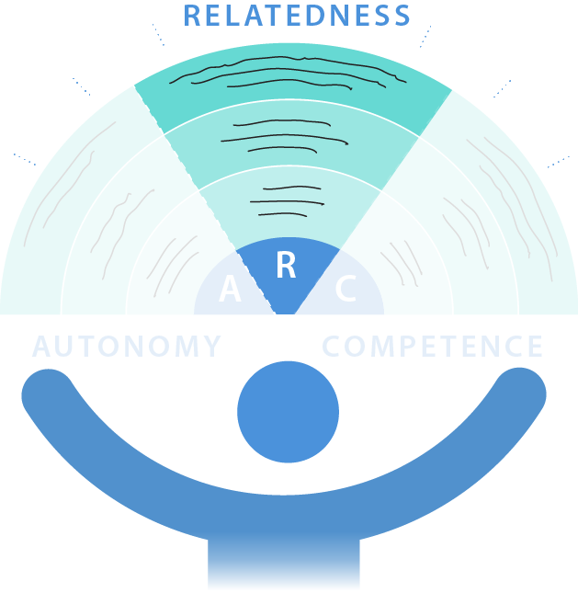
Youth Who Thrive
Programs that promote relatedness provide:
inclusive environments
consistent youth-adult relationships that last at least 6 months
frequent youth/adult contact, involvement, and closeness
Notes:
A strong bond established between an adult and a youth participant appears to be important for program success.
Program length and program attendance are linked to positive youth outcomes. The contact time within the program is vital for greater success.
Programs building relatedness can be successful within the school setting and outside the school setting. The best evidence at present for the nature of such programs comes from within the school setting.
Successful programs within the relatedness critical factor tend to focus on young people’s Development Assets or a similar framework.

Slide 16
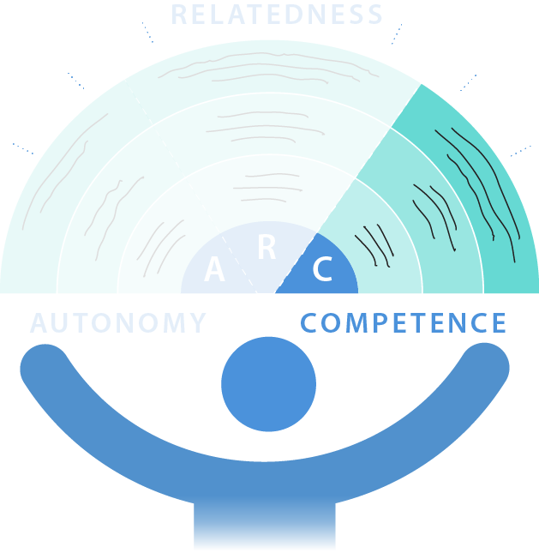
Youth Who Thrive
Programs that promote competence provide:
opportunities for skill building, mastery over time
opportunities to develop emotional, social, and cultural competences
opportunities to interact with youth with diverse perspectives and backgrounds
Notes:
Competence approaches to intervention can be based on any one of a number of competences.
Developmental, cultural, and contextual elements may be particularly important to consider in designing competence interventions.
Health is a critical outcome of programs focusing on competence, most especially mental health.
Measuring the impact of youth programs on competence is a complex process because there seems to be a strong subject-treatment interaction effect, such that a program beneficial for one young person is not helpful for a seemingly similar young person.

Slide 17
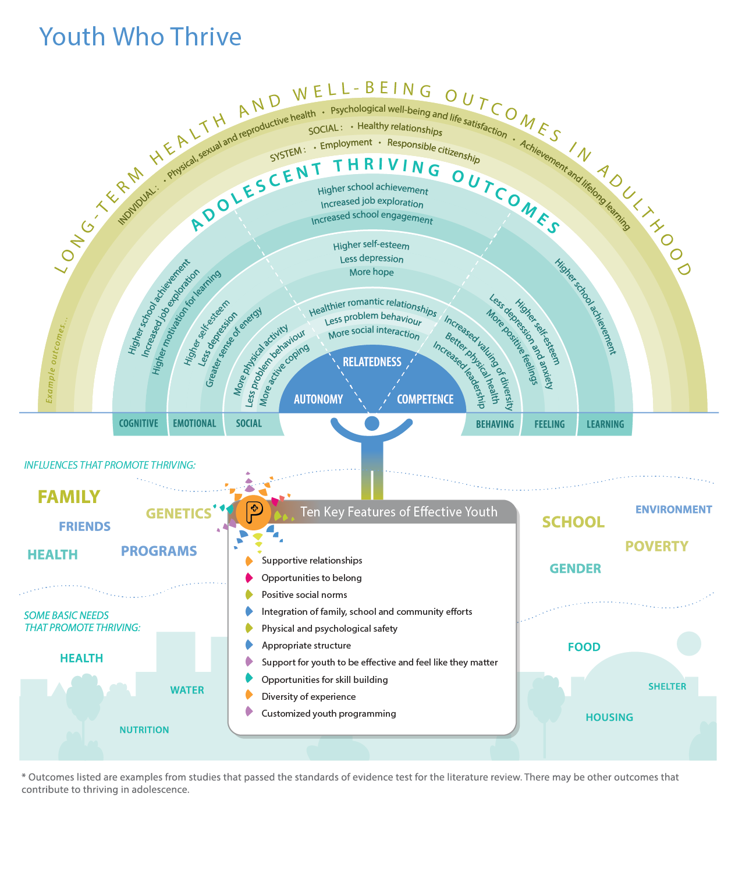
When youth are engaged in programs that support autonomy, relatedness, and competence, they experience thriving outcomes during adolescence and long-term health and well-being outcomes in adulthood.
Long-term outcomes include:
Physical, sexual, and reproductive health
Psychological well-being and life satisfaction
Achievement and lifelong learning
Healthy relationships
Employment
Responsible citizenship
Notes:
Thriving in adolescence generally leads to long-term health and well-being in adulthood. Young people who thrive during adolescence are more likely to feel psychologically and physically healthy, contribute to their communities, achieve success in education and employment, maintain strong relationships, and be satisfied with their lives as adults.

Slide 18
Research indicates that tailoring programs to youth is important.
The demographic profile of Toronto is unique.
More knowledge about tailoring programs to specific youth in the GTA is needed.
Engaging youth in decision-making and input into programs is an effective way of tailoring programs for the unique demographics GTA programs serve.
Notes:
Programs are more effective if they are tailored to the specific demographics of youth attending the program. Factors such as gender, socioeconomic status, ethnicity, sexuality and ability influence young people’s lives and the transitions they navigate.
Demographic factors are important to take into account in programs, but the research is insufficient and does not indicate how to tailor programs with these factors in mind. For instance, for young people living in poverty, having more autonomy may actually lead to higher delinquency, unless they have more guidance, structure and support in their lives and in the programs that serve them. The Toronto challenge is even greater as the demographic profile of young people in Toronto is so different from that found anywhere else in the world. Evidence from the review Youth who Thrive must be matched with on-the-ground efforts to translate research into the practical and particular settings each program serves, accompanied by documentation of what works effectively.
Our informed attention to how our programs work and why, and our willingness to share it, will help advance our sector’s contribution to assisting all youth in the GTA to thrive now and well into their futures. By doing so, we also help our city to thrive.

