Slide 1
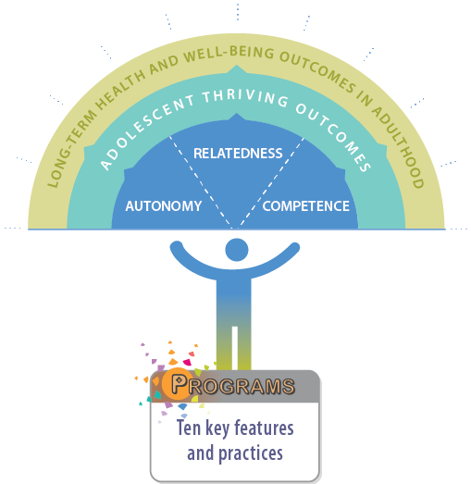
Designing Programs for Autonomy, Relatedness, and Competence

Slide 2
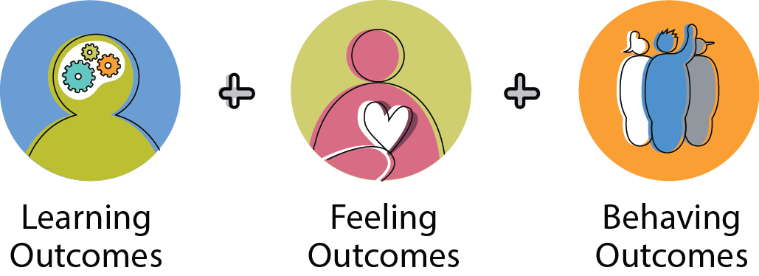
Global Outcomes
What long-term outcomes do we want to achieve?

Slide 3

Learning Outcomes
What short-term learning outcomes do we want to achieve?

Slide 4

Feeling Outcomes
What short-term feeling outcomes do we want to achieve?

Slide 5

Behaving Outcomes
What short-term behaving outcomes do we want to achieve?

Slide 6
Program Features and Practices
What activities and why?
Activity Outcome

Slide 7

Relatedness Program Features
Program features
Program practices
Supportive relationships
Opportunities to belong
Positive social norms
Integrating family, school, community efforts

Slide 8

Autonomy & Competence Features
Program features
Program practices
Physical, psychological safety
Appropriate structure
Youth being effective, feeling valued
Skill building opportunities

Slide 9

Autonomy, Relatedness
& Competence Features
Program features
Program practices
Diversity of experience
Customized youth programming

